Slide 1
BELL CRANK Mechanism
Prof. Sourav Rakshit
CRC 352
ME2202 : Kinematics and Dynamics of Machineries.

Slide 2
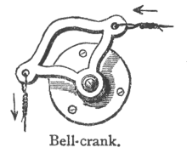
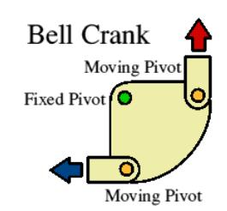
What is a Bell Crank?
A bellcrank is a type of crank that changes motion through an angle. The angle can be any angle from 0 to 360 degrees, but 90 degrees and 180 degrees are most common. The name comes from its first use, changing the vertical pull on a rope to a horizontal pull on the striker of a bell, used for calling staff in large houses or commercial establishments.

Slide 3

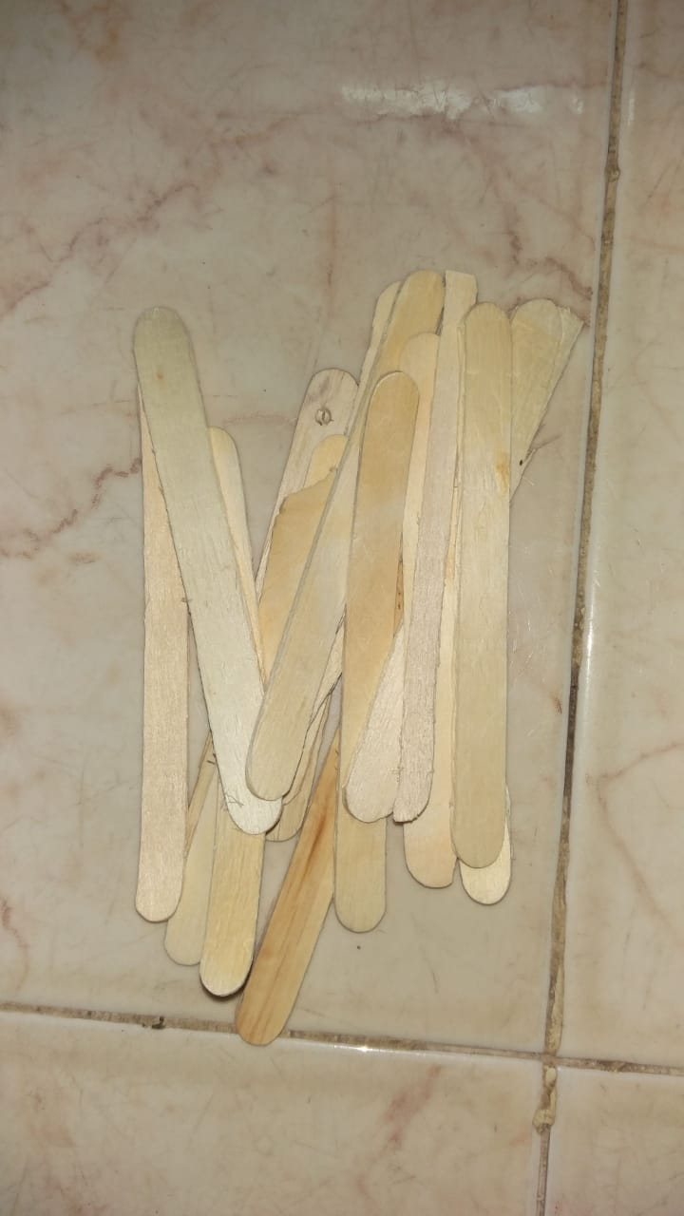

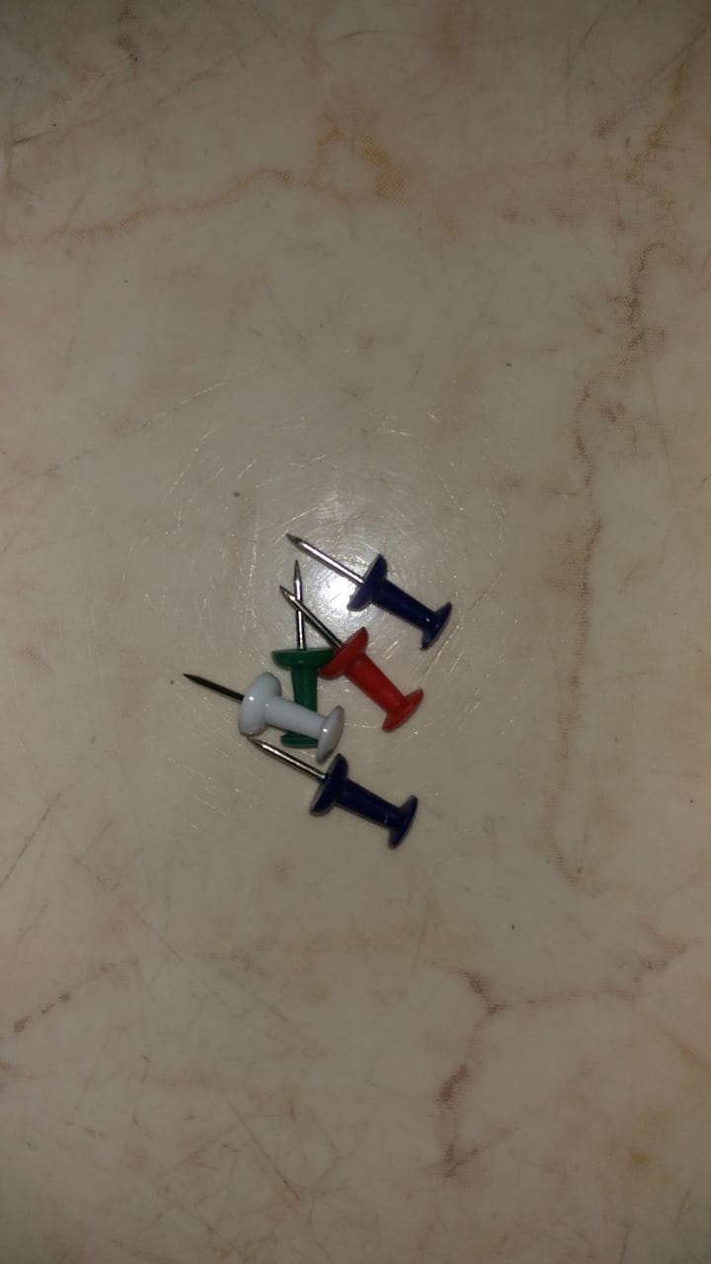

Materials Used
Card Board
Chart
Paper clip
Board pins
Icecream stick
Feviquick super glue

Slide 4
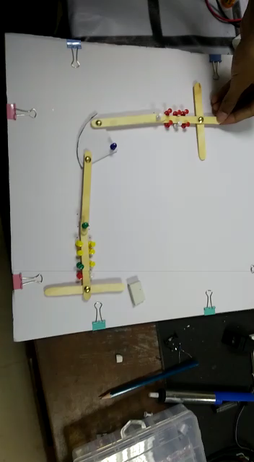
Trailer

Slide 5
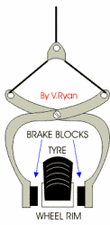
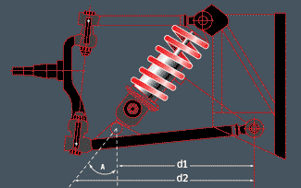
Real Life Applications
Automotive
Bellcranks are also seen in automotive applications, as part of the linkage connecting the throttle pedal to the carburetor, and connecting the brake pedal to the master brake cylinder. In vehicle suspensions, bellcranks are used in pushrod-style suspensions in automobiles or in the Christie suspension in tanks.

Slide 6
Mobility Analysis
6 links
2 prismatic pair
2 binary links
1 tertiary link
7 joints
2 prismatic pair
5 revolute joints
Mobility analysis :
N=6, J=7.
Degrees of Freedom = 3(n-1)-2j = 3(6-1)-(2*7) = 1.

Slide 7
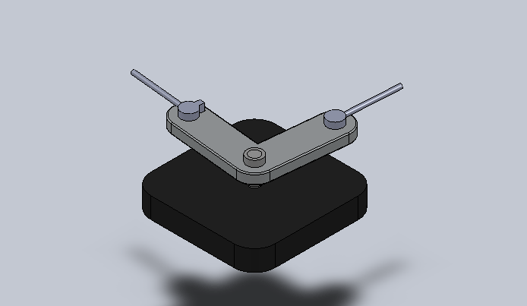
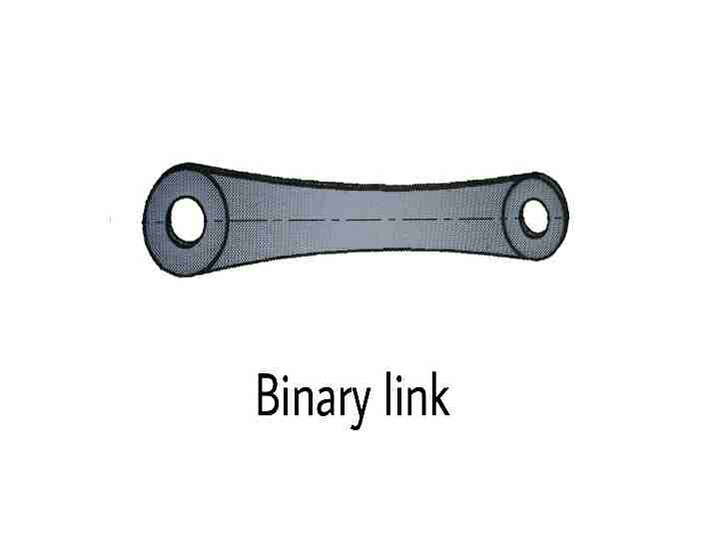
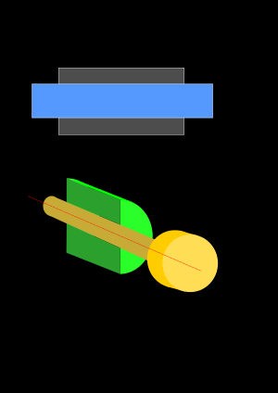
Components
Bell Crank
Prismatic pair

Slide 8
Kinematic Analysis

